Slide 1


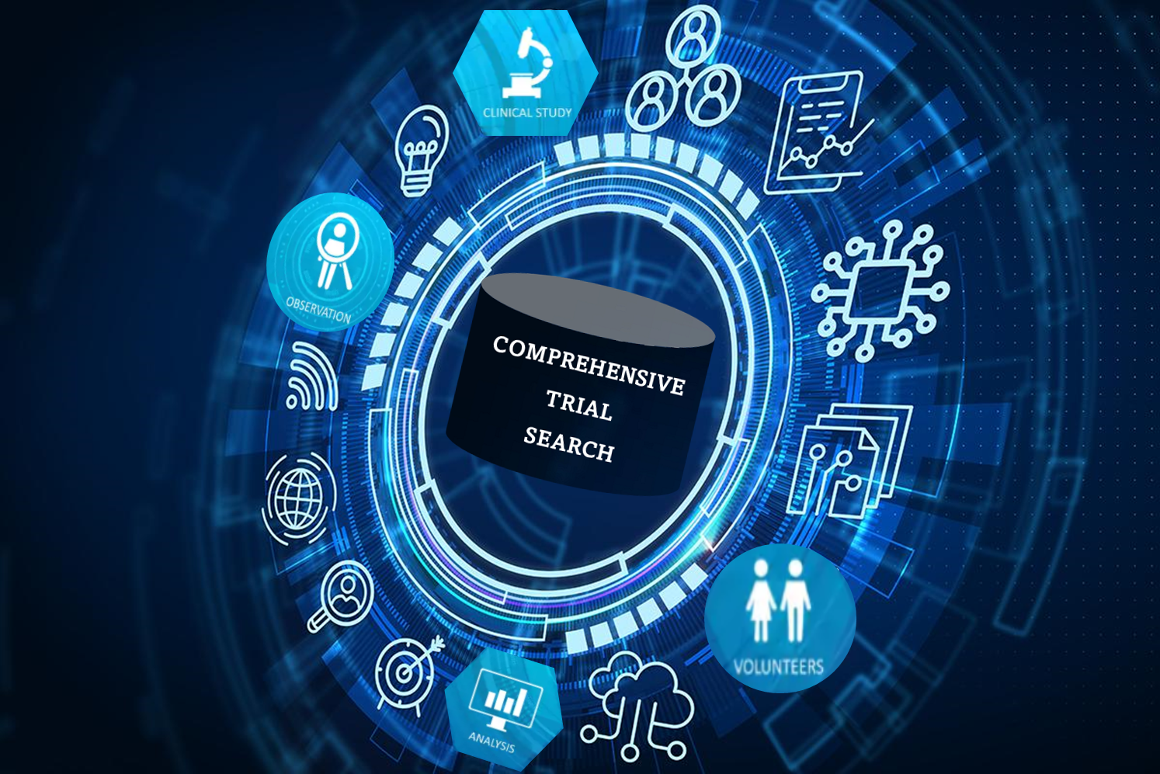
CLINICAL TRIAL SEARCH SUITE
Alden Jettpace
Austin Anderson
Nicole Koshy
Web Database Development

Slide 2
ABOUT THE APPLICATION
Clinical Trials are research studies conducted on human volunteers to test the behavior and efficacy of a given method of treatment or interventional therapy to treat a particular disease.
While traditional Clinical Trial repositories provide only summarized trial results, our application allows users to cross-reference additional curated information related to trials in one place.

Slide 3
WHO ARE OUR USERS
HOW IS IT USEFUL?
Retrospective analysis of trials to design future trials.
Understand the status of currently ongoing trials in a specific area.
Analysis of patient enrollment, country involvement and participating entities in trials in different disease and geographic areas
Research scientists
Pharmaceutical companies
physicians
Healthcare analysts

Slide 4
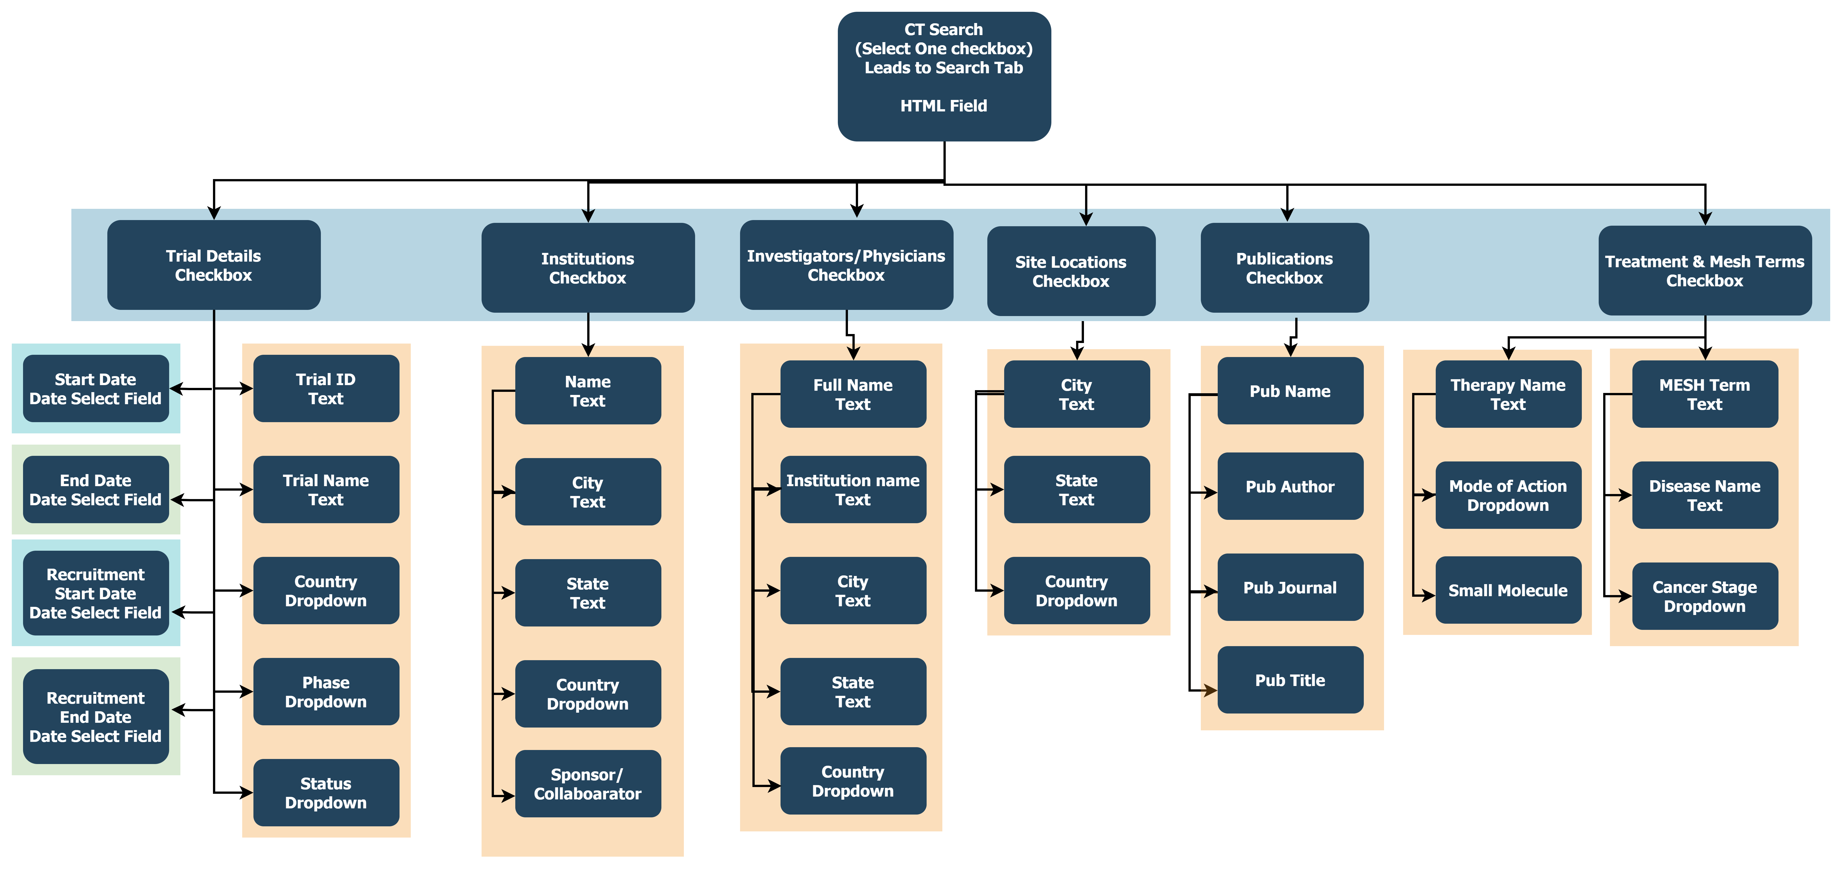
Multivariate search

Slide 5
How are we different
Clinical repositories have searches centered around Trial study details.
With our application, users can create multi-variate searches that can include a combination of search parameters targeting:
Trial Study details
Participating Institutions
Mesh Term based search
Managing personnel
Sites where trials are conducted
Associated publications

Slide 6
Technical specs

Slide 7
architecture
Main Pages (visible layer)
Homepage
Login
Registration
Search Form
Trial Specific Results
Search Results
Application Pages* (invisible layer)
Header
Login Captcha Handler
Login Handler
SQL Connect
Registration Handler
Application Functions
Logout

Slide 8
DATA management
Trial Details scraped from Clinicaltrials.gov
Institution, Site, Personnel and Publication information manually gathered or scraped from verified sites
Database set up with independent entities linked together with bridge tables to connect trial details to supplementary information

Slide 9


Security
Password hashing
Prepared Statements to prevent SQL injection on all pages
Captcha login to prevent bot spamming
Headers & Session Instantiation: Ensures pages cannot be accessed unless user is registered and logged in

Slide 10
Search input & RESULTS
Dropdown lists linked to defined lists in files.
Autocomplete for certain fields linked to relevant table columns in the database.
After initial results are displayed, additional parameters can be added to further refine the results.
Search Results displayed with dynamic links that display complete trial information or links to associated entities (Institutes, Publications, Personnel, sites).

Slide 11
stylization
Flex
Bootstrap Elements
Toggling Filter categories & Results tables
Design templates for search and results containers
Table styling
Page & Background styling

Slide 12
HOW IS OUR SEARCH SUITE DIFFERENT
OUR SITE
Clinicaltrials.gov
EUDRACT

Slide 13
responsibilities
alden
austin
nicole
Front end & Application implementation
Stylization
Data Curation & Application design

Slide 14
POTENTIAL ISSUES
Certain parts of application layer don’t have [header: location] measure to make sure user cannot access page in improper use
Captcha in sign-in but not registration means that while bots cannot overload site traffic, they could overload user-database
Mitigate in future by adding captcha-system to registration too

Slide 15
FUTURE PROSPECTS
The database is setup for continuous data updates which can be setup with Stored Procedures
Search Modalities can be expanded to provide more granularity to searches.
Search parameters can be stored for users to return to.
Results can be made downloadable for further analysis.

Slide 16

Thank you

